Slide 1
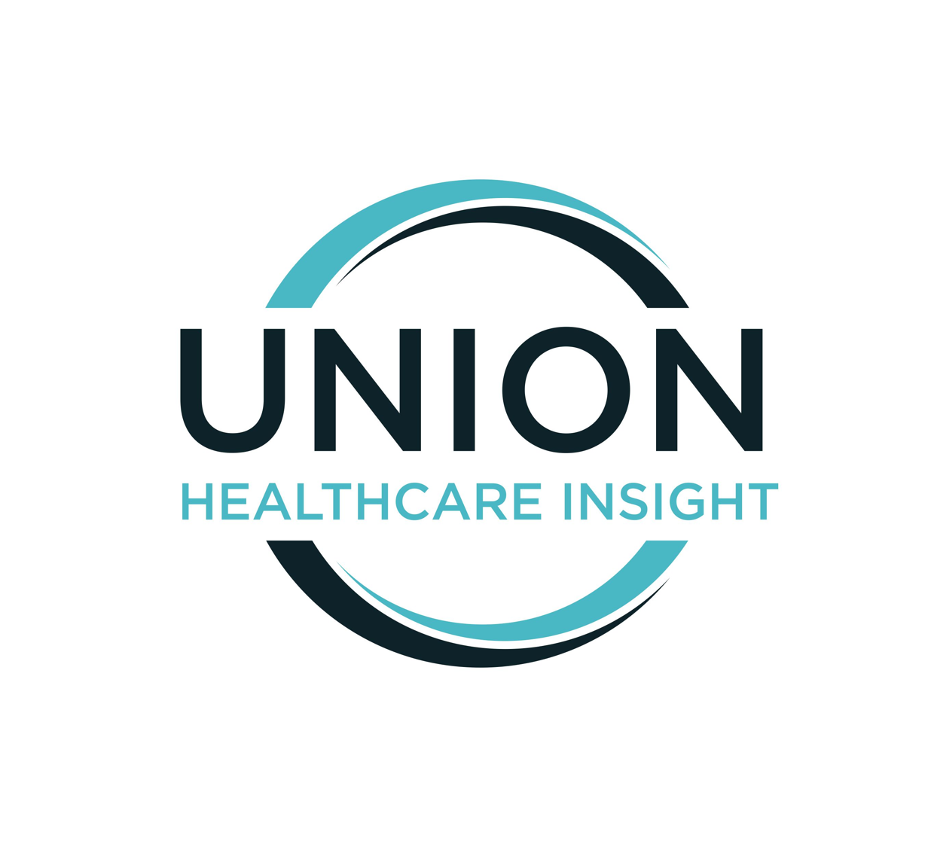
How to speak pharmacy/
’the drug ecosystem’ in 2023
Strategy Bootcamp
Notes:
Pharmacy, AKA ‘the drug ecosystem’ is one of the most arcane and challenging of healthcare market subtopics. But that doesn’t mean one cannot get up to speed on it – it’s completely doable, as long as we take it step by step. That is our goal in this strategy bootcamp module.

Slide 2
Pharmacy is an essential topic because it is (1) required and (2) easy to put a foot wrong
Required
- Pan-industry– conversation topic and newsmaker
Easy to Go Wrong
- Infamously complex, opaque value chain
- Jargon intensive – spanning technical, clinical, investment, healthcare business contexts
- Many subtopics
- Many players
- Massive economic activity in this sector. Pharmacy may represent a cost problem, and/or a revenue opportunity, for many players
- On the clinical side: life/death stakes for patients and families
- Significant market sensitivities
- Moves fast; easy for information/knowledge to be out of date
Notes:
Like all of our bootcamp topics, pharmacy is a must-understand part of healthcare for many of us. Pharmacy (which is shorter to say than ‘drug ecosystem’) drives news and shapes the market because so much innovation and so much money both flow through it all the time. It’s issues are both gnarly and high-stakes. It is quite easy to go wrong in this topic mostly because it fights understanding. The value chain is complex and purposefully opaque. People discussing this area need to be familiar with some pharmacy-specific jargon not commonly used in the rest of healthcare. It’s a political topic in which there are real sensitivities that one needs to be aware of. And it’s constantly changing.

Slide 3
Five savvy-generalist cornerstones for any strategy topic
Topical Pillars in All Union’s Strategy Bootcamp Modules
01
Language
Recognize and use core concepts and specialized terms
02
High-level trends
Know the big patterns and trends: Utilization, investment, reimbursement, regulation
03
Market diplomacy
Areas of high sensitivity, major topics. Develop a set of informed, yet non-controversial, talking points
04
Focus areas (and economics) by sector
Each major player’s goals and activities in this area
(e.g. payers, providers, employers)
05
Some key players
A handful of anchor organizations/ people/ information sources to know
Appendix: A short, current reading list of additional, optional deep dives
Notes:
But again– getting up to speed is doable as long as we take it one step at a time. Here are the layers we are going to use to make sure everyone feels confident conversing in this space.

Slide 4
Section 01
The language and key concepts in drugs/pharmacy
Notes:
Starting with language and key concepts

Slide 5
A simple overview of how drugs reach end users
Notice that insurers, PBMs play no role in the physical movement of drugs from place to place
Pharmaceutical companies
Wholesalers/ Distributors
Pharmacies (dispensing)
Patients
Storage, inventory management, distribution
Retail pharmacy
-Inpatient, outpatient, specialty pharmacies
- Fill Rx to take at home—or, receive medication administered by clinician
R&D
FDA approval
Source raw materials at scale/
Manufacturing
Marketing/
sales
Prescribers/
prescribing
Notes:
If you’ve spent any time in the drug/pharmacy space, you may have seen an insanely convoluted picture of the drug value chain. Here is a vastly simplified version that walks through the physical flow of drugs from development and manufacturing to distribution, prescribing, dispensing, and the end user.

Slide 6
A (comparatively) simple overview of drug pricing
Separate ‘pricing’ from the overall ‘value chain’ to establish a fact base before digging deeper
Pricing process
Manufacturer
(i.e., pharma)
list price-- known as the Wholesale Acquisition Cost or WAC—start point for negotiations with insurers for commercial and Medicare Part D (prescription drug) plans
The average WAC, minus any rebates or discounts, across wholesalers is the Average Sales Price (ASP); it forms the basis for Medicare Part B (specialty drugs) pricing
Insurers/PBMs each negotiate a different price with the manufacturer
Manufacturers may also offer additional rebates to secure a lower-cost tier placement for their drug
Insurer/PBM
places drug into formulary. Formulary tiers determine pricing for patients.
Pharmacy reimbursement/ dispensing fees, are negotiated among pharmacies, PBMs, and insurers
Wholesalers may offer additional discounts to specific buyers – hospitals/systems, medical groups, pharmacies
Patient cost sharing
Determined by insurer/employer (aspect of benefit design)
Manufacturer may offer patient assistance programs; assistance may or may not count toward insurance deductible ‘see ‘copay accumulators’
Notes:
Now that we’ve separated out the physical movement of drugs from place to place, it’s time to tackle the hairiest beast in the pharmacy/drug value chain: The pricing process. This is where you can get infographics with bewildering dotted lines and arrows that curve back in on themselves. Let’s simplify things so that you have a base-case understanding of the GENERAL linear flow of how drugs are priced and paid for.
Of course there are exceptions and caveats, which you may or may not need to know about depending on how deep you’re wading into this territory. (For example, the pricing process actually works a little differently depending on the TYPE of drugs we are talking about—for example whether they are considered part D (retail-pharmacy-filled) drugs versus part B (physician-administered, medical benefit, specialty-type drugs). But we think this is a good start for getting grounded.

Slide 7
What if the ‘cost plus’ model takes off?
Mark Cuban’s Cost Plus; CVS’s CostVantage; Cigna’s Clear Network. If this model became the norm, what would happen to pricing?
Pricing process
Manufacturer
(i.e., pharma) sets list price
Insurer/PBM/pharmacy negotiates a lower price
- Price includes a (transparent) markup and dispensing fee (for itself, or for its partner pharmacies, if the negotiating entity is not a pharmacy)
Pharmacy is reimbursed at that rate
Patient pays whatever cost sharing arrangement is set by their benefit design
Source: Mathews, A. “CVS Plans to Overhaul How Much Drugs Cost”, Wall Street Journal, December 5, 2023
Notes:
We will talk a more about this in the PBM section—and the CVS profile- and the Mark Cuban Cost Plus profile ☺ Butt, for now, suffice it to say the complex and obscure pricing process, with its many middle entities, has attracted the attention of many looking for a better way. There is currently an upsurge in energy around the idea of a ‘cost plus’ model in pharmaceutical pricing, to simplify and lower drug costs. The most obvious pioneer of this approach, to date, has been the Mark Cuban ‘cost plus’ pharmacy. In December, 2023 CVS announced it would would be moving its pharmacies to a cost-plus model, and its PBMs will offer a cost-plus product/service to employer clients. Cigna’s PBM, ExpressScripts, has also announced a similar product, call Clear Network.

Slide 8
Term check: What is the ‘life science industry’?
This is the industry-preferred term for pharmaceutical, biotech and device-makers together
Pharmaceutical companies. Once, pharma companies only developed and manufactured chemical-compound or synthetic molecule drugs, leaving biologic drug development to biotech. Today ‘big pharma’ makes large molecule and biologic drugs (often via acquistions).
Pharma
The term ‘biotech companies’ tends to refer to startups focused on development of therapies that use living organisms or biological processes.
Device
Biotech
Device-makers produce instruments, machines, or implants that can be used for diagnosis, treatment, or prevention
Notes:
The preferred term for ‘drug company’ is LIFE SCIENCE. (‘the life science industry’’ ‘ a life science company’). There are three major kinds of businesses in this terrain – and then a big ecosystem around them, which we will get into in the next slide. There is a messy overlap among these companies, but GENERALLY SPEAKING, ‘pharma’ companies focus on developing drugs using chemical compounds or synthetic materials; they may also develop biologics (or at least, they now own former startup biotechs that do). Big pharma is optimized for getting FDA approvals and marketing, which smaller biotech companies may not be set up to do.
Smaller biotech companies, including some that are true startups, tend to be laser focused on developing a single drug or a smaller portfolio of drugs. If successful, their exit may be that they get acquired by a big pharma company.
Device-makers are the smallest slice of the life sciences industry and are sometimes not part of the conversation if that conversation is strictly about drugs—but they are the third category of ‘life sciences’ companies.
(See also this blog post about halfway down the page: https://www.alacrita.com/blog/whats-difference-biotech-pharma)

Slide 9
Why are these companies lumped together?
Note big companies may span business lines
Commonalities
Differences
Player attributes
Focus areas
'Pharma’
Run clinical trials
Pharma | Large, established companies | Developing therapies to treat both common and rare diseases Gaining FDA approval for novel drug assets and new indications of existing assets
Biotech | Often smaller, more specialized companies relying on partnerships and collaborations | Often focus on novel and complex treatments: Gene therapies, cell therapies, personalized medicine
Device | Diverse mix of companies, from large, established players with broad portfolios to niche startups | Surgical instruments, imaging equipment, prosthetic devices, diagnostic tests, and more
Research partnerships with academic and provider organizations
Considerable regulatory oversight
Economics: High R&D costs, hit-or-miss products, pressure to demonstrate value (i.e., defend pricing) to payers and patients.
Source: Pharma/biotech revenue data: Motley Fool/Evaluate/Statista, 2022. Available here; devicemaker revenue data: Statista, 2022 available here
Notes:
The three companies are grouped into ‘life sciences’ because they have some key elements in common; see left. On the right, key differences.

Slide 10
Surrounded by a big economic ecosystem
Therapeutics, as a sector, drives massive financial, informational, and regulatory activity
Information technology vendors
Professional services
Tech solutions such as (or including) CRM, workflow, AI
Advertising, consulting, staffing
Value chain participants
Legal, regulatory and public relations
Diagnostics companies; providers (health systems, medical groups), pharmacy benefit managers (PBMs), wholesalers, distributors;
disruptors (e.g., GoodRx, Amazon Pharmacy), insurers/payers
Food and Drug Administration (FDA), Center for Medicare and Medicaid Services (CMS)
Lobbying groups (PhRMA, BIO)
STAT News, Drug Channels
Notes:
According to a report by Biocom California and the California Life Sciences Association (CLSA), about four and a half million people are employed in the US IN and AROUND the life sciences industry. Hopefully that number helps bring into focus the massiveness of the professional/industrial ecosystem.
Note we will be delving more into some of these players and types in coming slides. For now, the point is that the life sciences industry is not solely comprised of drug and device manufacturers—the world is bigger than that and it intertwines with many additional pieces and parts of healthcare.

Slide 11
Pharmacy/life science is a jargon-intensive terrain
The three major sources of arcane language
Policy/
Regulatory terms
Specialized
Business terms
Clinical terms
Notes:
We’ve gotten as far as we can using common English –or at least, healthcare-common English. It’s now time to embrace the fact that we will need a bit of a specialized lexicon to talk about key pharmacy and drug ecosystem dynamics. In this section we will cover the absolute basics you need from three jargon-generating elements of the drug ecosystem: Clinical terms, policy/regulatory terms, and specialized business terms. We can do this.

Slide 12
Clinical and regulatory/policy terms to know
Be ready to recognize these terms in coverage, conversations
Clinical terms
Regulatory/ policy terms
Small-molecule drugs: Synthesized chemically, administered orally
Lage molecule drugs, AKA “biologics”: Produced using living cells, such as bacteria, yeast, or mammalian cells, and are often administered by injection or IV.
Immunotherapies: Drugs that harness the immune system to treat cancer instead of using chemo, radiation, or surgery. E.g. the very-high-dollar CAR-T. Often used to treat cancer but in future could treat other diseases as well.
Real-world evidence (RWE): Clinical data about use, cost, and efficacy of drugs, from any source—patient reported data, claims electronic medical records, or other.
340B: Controversial Medicare program entitling some provider organizations (‘covered entities’) to discounts on outpatient prescription drugs. More detail follows
Medicare Part B drugs: (‘specialty’ drugs) Drugs administered by a provider in a clinical setting. E.g., chemotherapy, injectable medications and immunosuppressive drugs (more toxic, more expensive)
Medicare Part D drugs: Patient-administered, pharmacy-filled drugs.
Notes:
The most common clinical terms you will run into in the pharmacy/drug ecosystem space are here on the left–mostly types of drugs or diseases that are very hot in drug development these days. On the right: Key regulatory and policy terms, including the ever-controversial ‘340b’, and the ever-present Medicare part B vs Part D distinction.
Less common—but included here because absolutely not recognizeable using common English—and a key general concept in drug ecosystem value: the QALY, pronounced “kwaly”. As noted in the slide, US policymakers do not use this word and instead, the term is confined to discussing international approaches to comparative effectiveness (AKA bang for buck) of drugs; in the US it is more politic to discuss “outcomes” – survival, disease progression, quality of life – and avoid discussion of placing a dollar value on benefit for cost. This is a way of sidestepping hot-button debate about rationalizing coverage of care (for example, think of the political blow-up over the idea of ‘death panels’)

Slide 13
Business terms to know
Fittingly, the pharmacy world has developed its own arcane language to discuss its opaque value chain
Business
The Wholesale Acquisition Cost (WAC): the list price that drug manufacturers set for their products. Acts as a starting point for negotiations re: discounts, rebates, or other price concessions that may be offered to pharmacy benefit managers (PBMs) or other purchasers.
‘Trend’– as in ‘healthcare trend’ or ‘pharmacy trend’ without specifying WHICH healthcare trend – means ‘trends in total spending. (Employer/payer term)
Gross-to-net bubble: The difference between the list price versus the actual price; has been quite high due to pharmacy value chain dynamics
Drug channels: the complex network of manufacturers, wholesalers, distributors, pharmacies, pharmacy benefit managers (PBMs), insurers, and other intermediaries involved in the distribution and reimbursement of prescription drugs– each of which adds its own markups, fees, and rebates.
Notes:
Now let’s talk through a few critical business terms. These are the ones that we find bubbling up the most often in industry coverage and conversations. It’s OK if you’re not comfortable USING these terms fluently. The most important thing is to be able to RECOGNIZE then when they are used and connect them to their meaning so that the conversation or coverage makes sense overall.

Slide 14
One more: ‘White bagging,’ which needs its own slide
An explanation in seven points
1. White bagging is a term that only applies to Part B (infused or injected) drugs
2. Previously, doctors and hospitals would purchase Part B drugs, add a mark-up, and bill the patient's medical insurance
3. About 15 years ago, payers hypothesized that they could reduce cost by moving some Part B drugs from the medical to the pharmacy (Part D) benefit. This practice became known as "white bagging."
4. Under white bagging, providers can no longer bill the patient's insurance for the drug. Instead, the patient must acquire the drug through their in-network specialty pharmacy, have it paid for by their PBM, and then have it administered by the provider.
5. One of the implications, and one way it saves payer cost, is that it cuts providers from the drug revenue chain.
6. Some providers like this because it relieves them of the risk associated with trying to secure reimbursement for high-cost drugs. Other providers do not like white bagging because they want the revenue, and/or, are looking to avoid additional costs and risk that come from administering a drug supplied by an outside party.
7. One workaround that providers have devised to continue participating in the drug revenue chain is to start their own specialty pharmacies and require patients to buy the drugs from them (still reimbursed by the PBM).
Notes:
One more key business term: White-bagging. This is an important concept in the drug ecosystem because it pertains to whether and how providers participate in the drug revenue chain for part-b (provider-administered) drugs. Explanation on slide.
Once you’re through this final piece of pharmacy vocabulary, let’s turn to understanding high-level trends and patterns.

Slide 15
‘Value’ terms to know
Discussions about drug value have their own constellation of key concepts and terms of art
‘Financial toxicity’ – adverse financial effects of medical expenses, highlighting similarities with the toxic side effects of of some treatments
Value
Patient assistance programs – free, discounted, or copay-assisted medications provided by manufacturer for patients who meet eligibility criteria
Outcomes-based pricing – Making manufacturer reimbursement contingent on defined outcomes
‘Copay accumulator’: Insurance policies that do not allow manufacturer copay assistance or coupons to count toward a patient's deductible or out-of-pocket maximum. Keeps patient exposed to overall drug price
‘Clinical trial end points’: The measures used to assess trial outcomes e.g., survival, disease progression, response rate, symptom improvement, or specific laboratory or diagnostic results. Factors into value discussions about what ‘end points’ are worth developing new drugs for, at what cost
QALY (quality-adjusted life year): A method used abroad, especially in the UK, to assign a price that the government is willing to pay for a drug based on its ability to support additional (quality adjusted) life years. This term is studiously avoided by US policymakers due to political sensitivities (‘how do you put a price on an extra year of life?’)
Notes:
On this slide are a set of ‘value’ related terms to recognize and be able to use.
A note on outcomes-based pricing: Here are a couple of examples: CAR-T Cell Therapies: Chimeric Antigen Receptor T-cell (CAR-T) therapies, such as Kymriah (tisagenlecleucel) and Yescarta (axicabtagene ciloleucel), used for the treatment of certain types of blood cancers, have been the focus of outcome-based agreements. These agreements often involve payment adjustments based on patient response rates or durability of response. Hepatitis C Antivirals: Drugs like Sovaldi (sofosbuvir) and Harvoni (ledipasvir/sofosbuvir) used to treat hepatitis C have been associated with value-based agreements. These agreements often include performance guarantees and discounts based on treatment success rates, such as achieving sustained virologic response (SVR).
A note on clinical trial end points: it’s an important nuance to avoid saying, in the context of a value discussion, anything about "the goals” of any given medication; instead one would say "the measures that will be used to evaluate the outcomes of the trial" or something like that. Clinical trials are initially designed with the goal of gaining FDA approval. Endpoints are not chosen to demonstrate value. Rather the goals are 1) to quickly enroll patients who are likely to have a positive response and 2) produce enough data to meet the FDAs standards. The FDA does not require new drugs to perform better than existing drugs. Nor do they require that drug makers use a standardized set of measures. This makes comparing drug A to drug B, as one would need to do in determining comparative cost-effectiveness, very difficult. After approval, drug makers could theoretically run additional trials designed to demonstrate value. But trials are expensive. And there's the risk that the drug proves less valuable than they thought. So these kinds of trials are rare.
A note on ‘copay accumulator’ – this term is not as common as the others on this slide, but we have included it because it’s so uninterpretable in common English.
A note on QALY – if someone is talking QALYs, they’re also going to talk about NICE, the UK’s body that determines pricing based on cost-effectiveness. They’re also going to talk about ICER, which is a US-based drug effectiveness think tank that produces conceptually similar guidance about efficacy but which has no regulatory power at all to actually set prices. If you actually find yourself down this rabbit hole, know that the absolute price PER QALY (actual or de facto) varies by country, roughly based on GDP per capita across countries –see this article. https://www.thelancet.com/journals/langlo/article/PIIS2214-109X(23)00162-6/fulltext. As a very, very rough ballpark comparison, in this type of analysis, in US dollars, Canada ends up paying about $44K per QALY; the UK QALY is priced at about $37K; and the US super-soft threshold is about $150K.

Slide 16
Section 02
High-level trends
Notes:
You do not need to track absolutely every data point and trend in pharmacy and the drug ecosystem. However, there are some major patterns that anyone wanting to be conversant in this area should be aware of.

Slide 17
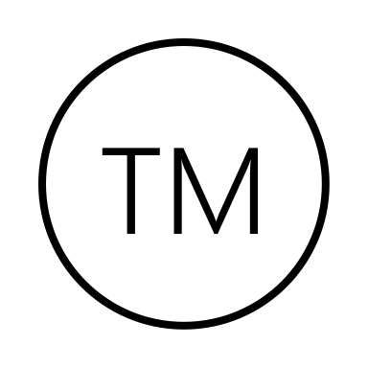
Let’s characterize some key patterns in Rx drug spend
Projected Annual National Health Expenditure Growth Rate By Category, 2022-2031
Key Patterns to Know
Rx drug spending increases tend to be driven by changes in price more than changes in utilization (number of prescriptions filled)
Non-retail (e.g., specialty) spend growth is faster than retail spend growth
Brand name drugs (versus generic drugs) and the top-10 costliest drugs both represent a disproportionate share of total drug spending
Overall
Hospital
Physician/ clinical services
Rx drugs
Source: Keehan, S. et al. “National Health Expenditure Projections, 2022–31: Growth To Stabilize Once The COVID-19 Public Health Emergency Ends,“ Health Affairs, June 14, 2023. ASPE. “Trends in Prescription Drug Spending, 2016-2021”.
Notes:
Having gotten grounded, now let's turn to some recent trends, starting with the very biggest picture in health spending – national health expenditure (NHE) data. Not on the slide, but prescription drugs are not at all the biggest pie slice of NHE; drugs represent approximately only about 9% of NHE. Rx drug spending GROWTH contributes to NHE GROWTH – but even this growth rate is not as high as growth rate in some other NHE categories. RX spending growth is a bit under overall NHE spending growth rates – 4.6% per yer projected from now until 2031, versus 5.4% for NHE overall.
Nevertheless, drug spending continues to be perceived as a massive issue – and an INFLECTABLE one, which is key because it drives legislative and market energy. Drug spending increases tend to be driven in price more than utilization; it tends to be concentrated in certain kinds of drugs (specifically, specialty not retail drugs), and in brand name and top-10 most costly drugs. For anyone who isn't sure, specialty drugs are basically, more complex, also more toxic, and more expensive drugs than the ones you could fill a prescription for over the counter and administer at home. Many specialty drugs are injected by a clinician in a clinical setting. Think "oncology drugs" as a key category here.

Slide 18
Understanding the ‘why’ of drug spending trends
Why pharmaceutical spending is so high—and its ongoing trajectory so steep
Factors driving up drug spending
Price increases
Utilization increases
New medications
Each year, manufacturers raise the price of a share of existing drugs. Price adjustments usually happen twice a year, in January and July
Each year some new–often costly–medications are approved to treat previously untreatable conditions.
Due in part to an aging population and rising chronic disease rates, the number of active prescriptions in the U.S. is on the rise.
Notes:
It is one thing to understand what the spend trends are—it is another to understand the contributing reasons why. To start to get our arms around this topic, consider this framework—which does not show the RELATIVE contribution of each kind of factor, only what they conceptually are. On the left, price issues. Drug prices in the US are significantly higher than in other countries—that is a fact. Price inflation also exceeds the rate of overall inflation. We will talk in a moment about different views on why/whether that is a problem. In the middle—the fact that the universe of drugs is always growing, which both raises the total and average spend (because new drugs are high-priced) and also increases utilization (because new patients are being added to the mix). On the right: Utilization factors.
Further reading:
Price increase data: https://aspe.hhs.gov/sites/default/files/documents/d850985c20de42de984942c2d8e24341/price-tracking-brief.pdf
Utilization data: https://aspe.hhs.gov/sites/default/files/documents/88c547c976e915fc31fe2c6903ac0bc9/sdp-trends-prescription-drug-spending.pdf

Slide 19
Cheat sheet: Know these headline-grabbing, pricey drugs
Despite their (relatively) low unit prices, Ozempic and other GLP-1 drugs have sparked concerns about spending due to the widespread prevalence of diabetes, added market demand because of their weight loss side effects, and the long-term nature of the drugs (e.g., taken weekly, lifelong)
Drug | Maker | Drug type | Clinical target | U.S. Price
Hemgenix | CSL and uniQure | Gene therapy | Hemophilia B | $3.5M
Zynteglo and Skysona | bluebird bio Inc. | Gene therapy | Beta thalassemia and cerebral adrenoleukodystrophy | $2.8M and $3M
Zolgensma | Novartis | Gene therapy | Spinal muscular atrophy | $2.1M
Humira | AbbVie | Biologic | Arthritis | ~$84,000 per year
Leqembi (lecanemab) | Biogen | Monoclonal antibody | Alzheimer’s disease | ~$26,500 per year
Kymriah and Yescarta (CAR-T) | Multiple | Immunotherapy | Cancer | $300,000-$500,000 per infusion
Ozempic | Novo Nordisk | GLP-1 | Type 2 Diabetes | ~$900 per month
Notes:
It is helpful to have a vocabulary of (or at least the ability to recognize) some of the most expensive drugs, who makes them, and what they treat. Note these drugs are not especially ‘new’; every drug on this list except Humira and Ozempic came out between 2017 (first CAR T) and late 2022 (Hemgenix) .
Not shown on this table, but an interesting angle on pharma economics is that Pfizer’s COVID vaccine, known to insiders as ‘Comirnaty’, had a relatively low per unit price, but it was the best selling pharmaceutical in 2022 by revenue - sales were twice the next highest selling drug. As you probably already know from a patient viewpoint, it uses a novel technology (mRNA).

Slide 20
Section 03
Market diplomacy
Notes:
We are already moving fast into sensitive territories, because we are talking about spending, prices, and so on. Let’s tackle market diplomacy issues head-on, so that you can be prepared for open-ended conversations with a wide range of people who work in and around the drug ecosystem.

Slide 21
Market politics around the life sciences are intense
Be prepped to participate in these common industry conversations
Topic simplification
Pharma role in spend
Business practices defensible or not?
Price controls
Inhibiting innovation or protecting patients?
The 340B program
Defensible system, or too easy to game?
Topics to know
PBMs
Mitigating costs, or just fueling the fire?
Shortages
Obvious problem—non-obvious array of causes, potential solutions
Notes:
Here are five topics to be on the lookout for. The goal today is simply to make everyone situationally aware that these controversial topics exist, what their outlines are, how to identify a pro/con argument when you hear one. What you do with this knowledge is up to you, based on your personal and organizational goals and role in the conversation. We will also conclude with a set of relatively non-controversial, but well-informed, example talking points that we personally would feel comfortable using if the goal is to keep the conversation substantive, but on safe political ground.
Our topics are: Pharma role in spend– are these business practice defensible, or not? Price controls – do they inhibit innovation or protect patients? The 340b program – is it a defensible policy, or too easy to game? Do PBMs help mitigate avoidable drug costs, or are they just fueling the fire? And last but not least – everyone agrees drug shortages are a problem. But what are the causes, and what are the potential solutions?

Slide 22
Topic #1: Pharma role in spend patterns
What is the fundamental nature of the problem?
The pharma-advocate
The pharma-skeptic
High prices are the logical byproduct of necessary investments in vital research and development, allowing for lifesaving scientific breakthroughs
High prices reflect profiteering by drug makers, poor regulatory controls, and opaque value chains that exploit confusion and allow various middlemen to pad their bottom-line
What are the preferred interventions?
Industry-supported solutions
Government interventions
players who profit from drug sales (e.g. makers, distributer, PBMs) prefer alternative payment structures, non-profit assistance programs, discount cards to address cost
Wide range of potential reforms always on the table; most recently, the Inflation Reduction Act (IRA) gave Medicare a limited ability to negotiate prices
Notes:
I mentioned a moment ago that most observers can agree on some shared facts when it comes to pharma spending—but the WHY of spending trends, and specifically, pharma’s role in – that is a subjective area, so let’s tackle that one first. On this slide you can see there are two basic perspective “camps” when it comes to pharma role in spend patterns. On the left, when it comes to the fundamental WHY of the problem, a pharma-friendly explanation would be that high prices are the natural byproduct of expensive and risky investments in R&D. On the right, a more pharma-skeptical interpretation of the same fact base would be that pharma companies are inappropriately profiting – that they have managed to do this due to lack of regulatory controls, and by building an opaque value chain in which a wide range of middle-entities are taking a cut without delivering commensurate value back to the end purchaser.
Solution-wise, there are again two camps. On the left: The pharma-friendly set of potential solutions include ideas like ‘alternative payment structures’, which is mostly the same concept as ‘outcomes-based pricing’ mentioned earlier. Also, programs to help low-income patients facing insupportable drug costs, such as non-profit assistance programs and discount cards. On the right: the pharma-skeptical potential solution arsenal leans toward ratcheting up regulation. Including the most recent salvo, the inflation reduction act, which created a small list of drugs that Medicare can negotiate the price of. Many, many opinions out there about whether this legislation is fair and/or whether it will be effective in bringing down drug prices.

Slide 23
The IRA: Medicare’s shot across manufacturers’ bow
What are the Inflation Reduction Act’s (IRA) pharmaceutical provisions?
Price negotiation
Inflation rebates
Cost-sharing limits
CMS has picked ten drugs for “maximum fair price” negotiations; that price will take effect in 2026
The number of negotiable drugs will increase from 10 in 2026 to 15 in 2027 and 2028, then up to 20 every year following
Manufacturers will be required to pay a rebate back to the federal government for most Part D and several Part B drugs, if the average price of the drug increases faster than inflation
Several analyses have found that the majority of Medicare drugs’ prices increase more quickly than the inflation rate
The legislation includes several efforts to reduce costs for Medicare beneficiaries, including capping out-of-pocket costs for Medicare part D, capping insulin cost-sharing at $35 per month, eliminating cost-sharing for vaccines, and expanding eligibility for Medicare’s Part D Low-Income Subsidy Program
All those in favor…
The government projects that these measures will save $237B over 10 years; surveys in the U.S. have generally found high levels of support for price negotiation
All those opposed…
The pharma industry has come out strongly against the law, citing constitutional violations and impediments to innovation; the later was echoed by some GOP lawmakers
Notes:
Here’s a little more information about the IRA’s pharma-related provisions. There are three main pillars of the legislation in which the most-discussed currently is the price negotiation pillar. One thing to know about the drugs that are subject to this pillar is that CMS will only negotiate prices for high-cost drugs that don’t have competition. Right now, Part D plans (which are private) can and do negotiate drug prices on behalf of Medicare beneficiaries. Their primary negotiating leverage comes from the threat of excluding a product from their formulary (usually in favor of a competitor's product). Under the IRA, the government will be intervening in instances in which "the market" (i.e. supply and demand) has failed to produce a (non-manufacturer-determined) price. The selected drugs – picked in October of 2023, span diabetes, heart failure and kidney disease, blood clot and stroke prevention, blood cancers, and inflammatory conditions such as rheumatoid arthritis and psoriasis.
The second pillar is a rebate requirement if average drug prices increase faster than the rate of general inflation
And the third pillar caps Medicare beneficiaries out of pocket costs for certain drugs, such as insulin, and makes more patients eligible for a low-income subsidy.
Know that the pharma industry fought all these provisions hard and is still fighting them. Example quote: “The process is in no way a “negotiation,” and CMS chose to go beyond what was outlined in the statute, taking the most extreme stance to sweep in as many medicines as possible and be as punitive as possible”--PhRMA (industry advocacy group)
https://www.kff.org/medicare/issue-brief/explaining-the-prescription-drug-provisions-in-the-inflation-reduction-act/
https://www.specialtypharmacycontinuum.com/Policy/Article/10-23/HHS-Selects-First-10-Drugs-for-Medicare-Rx-Price-Negotiation/71555
https://catalyst.phrma.org/cms-guidance-on-ira-price-setting-process-doubles-down-on-bad-policy
https://www.fiercehealthcare.com/payers/cms-gives-early-look-how-it-plans-negotiate-part-d-drug-prices-2026
https://www.kff.org/health-costs/poll-finding/public-weighs-in-on-medicare-drug-negotiations/#:~:text=Eight%20in%20ten%20adults%20(83,Democratic%2C%20and%20three%2Dfourths%20(

Slide 24
Topic #2: The controversial 340B drug pricing program
Program details
Ensuing controversy
340B was created in 1992; the program requires drug makers who participate in Medicaid to give significant discounts to ”covered entities”
While participating pharmaceutical companies must give providers discounts for outpatient drugs, there is no requirement that discounts be passed on to patients
“Covered entities” are hospitals and providers that qualify for 340B discounts; almost 80% of 340B purchases are made by disproportionate share hospitals
Some have argued that eligibility for the program has become too broad: the number of covered entities increased >600% between 2000 and 2020, to reach 50,000
The original intent of the program was to help reduce costs of safety-net providers and “stretch scare government resources” to serve more patients
“Contract pharmacies” that gain access to 340B pricing from covered entities have been accused of profiting from the discounts without generating savings for patients
Recent legal activity
Last year the Supreme Court ruled that an attempt by HHS to lower hospital reimbursement for certain 340B drugs was improper and hospitals must be paid back
Many drug makers are imposing restrictions on how discounts will be paid (ex: limiting the number of contract pharmacies), prompting lawsuits and government investigations
Notes:
And now on to our next controversial topic in pharmacy/the drug ecosystem: 340b. In simplest terms, 340b is a federal program that’s been around for a long time but that drugmakers are constantly fighting—one that is currently a major support to the economics of hospitals and health systems. And also some for-profit companies that are not hospitals or systems, more on that in a second. 340b entitles healthcare organizations that serve a significant number of Medicaid recipients to buy drugs at a steep discount. Note that hospitals and health systems that serve many Medicaid recipients are often called “disproportionate share” (DSH, pronounced ‘dish’). But ”covered entities" includes DSH hospitals and also a smattering of other special categories, e.g. FQHCs, cancer hospitals, children's hospitals.
In any case, the difference between the discounted acquisition cost and reimbursement falls to the bottom line of the covered entity.
The program is controversial for multiple reasons—for example, as shown on the slide, discounts don’t need to be passed on to patients; eligibility for discounts is considered to be too broad; and also pharmacies that contract with ‘covered entities’ (the ones that qualify for the discount) are accused of profiting off what is meant to be a safety net program, including by charging higher prices for the discounted drugs which reduces the amount of savings that covered entities and patients receive. E.g. CVS, walgreens, rite-aid, Walmart and Kroger are all big players in this “business area”.
Further reading: https://www.commonwealthfund.org/publications/explainer/2022/sep/federal-340b-drug-pricing-program-what-it-is-why-its-facing-legal-challenges

Slide 25
Topic #3: Pharmacy benefit managers (PBMs)
Primary functions of PBMs
1
Negotiate prices, discounts, and rebates with manufacturers on behalf of payers
2
Create formularies outlining which drugs will be covered and at what levels
3
Set pharmacy reimbursement for all medications under the pharmacy benefit
The case for PBMs
The case against PBMs
PBM proponents argue that PBMs use their market leverage to guarantee lower prices for their clients, and that PBMs have the expertise to enhance population health through the pharmacy benefit and make evidence-backed decisions about coverage and logistics
PBM detractors have accused PBMs of increasing drug costs through contracts that obscure what PBMs are paying for drugs, as well as practices like spread pricing (i.e. reimbursing pharmacies for less than is charged to the payer), and purposely selecting higher cost drugs in order to collect higher rebate payments
“Not only do PBMs negotiate better net prices from drug manufacturers and pharmacies, they also reduce waste, improve medication adherence, encourage the use of generics and affordable brands, offer more convenient delivery, and drive quality rather than quantity of care” - Adam Kautzner, President of Express Scripts
“PBMs have been allowed to rob patients, small businesses, and taxpayers blind for decades…With this bill, we can hold PBMs accountable for their role in increasing the cost of health care and pocketing taxpayer money.”
- Rep. Earl “Buddy” Carter (R-GA)
Notes:
Controversial topic area number 3: Pharmacy benefit managers or PBMs are corporate entities that are considered the “ultimate middle entity” in the drug value chain. As shown across the top of the slide, here’s what they do officially. … [read functions]. In addition to what is here, note that PBMs also play a role in setting patient out of pocket expense for drugs in the form of co-pay and co-insurance.
Unofficially, drug makers blame PBMs for making drugs unaffordable – of course PBMs claim drugmakers are the ones making drugs unaffordable. Each uses the other as a political scapegoat.
All PBM critics points to the fact that PBMs make money off the size of rebates, which are calculated as a percentage of the drug’s cost. That means that the bigger the cost, the more running room there is for “discounts”, meaning there does appears to be some misaligned incentives and some question as to whether PBMs are actually bringing costs down.

Slide 26
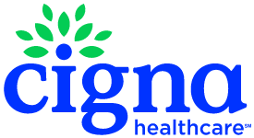
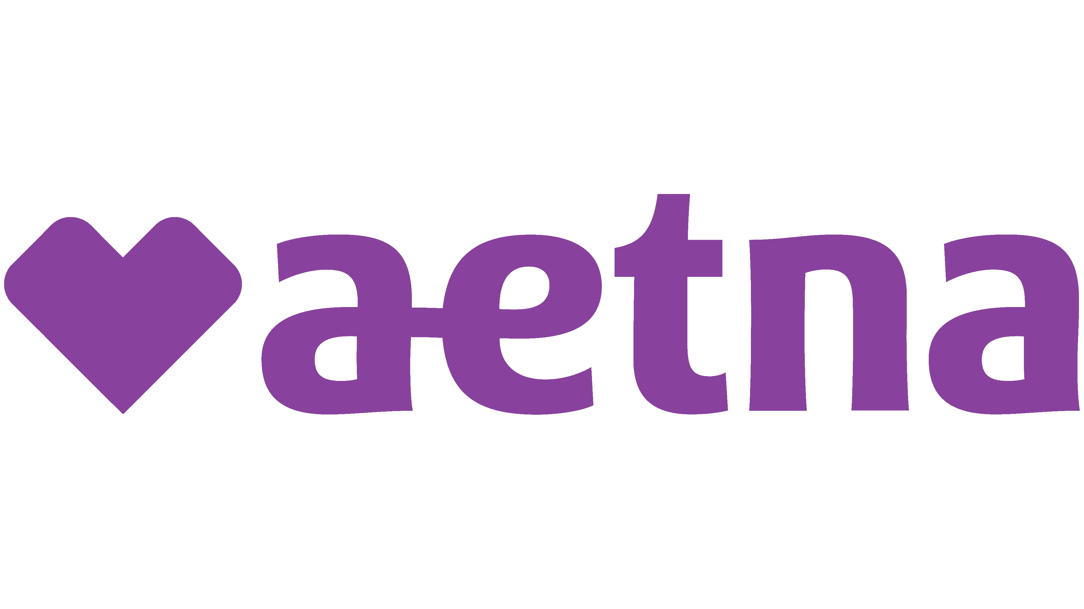
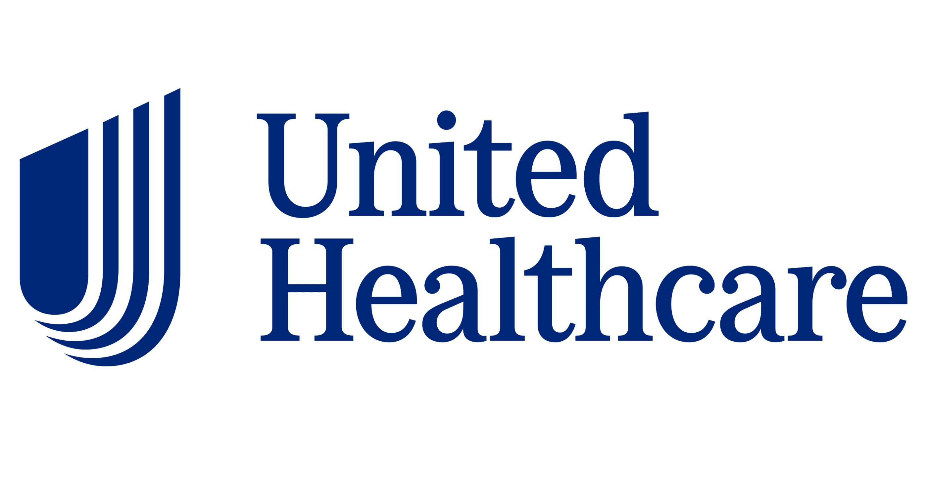
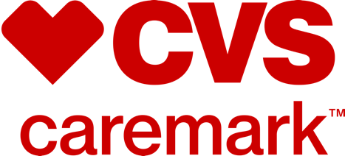
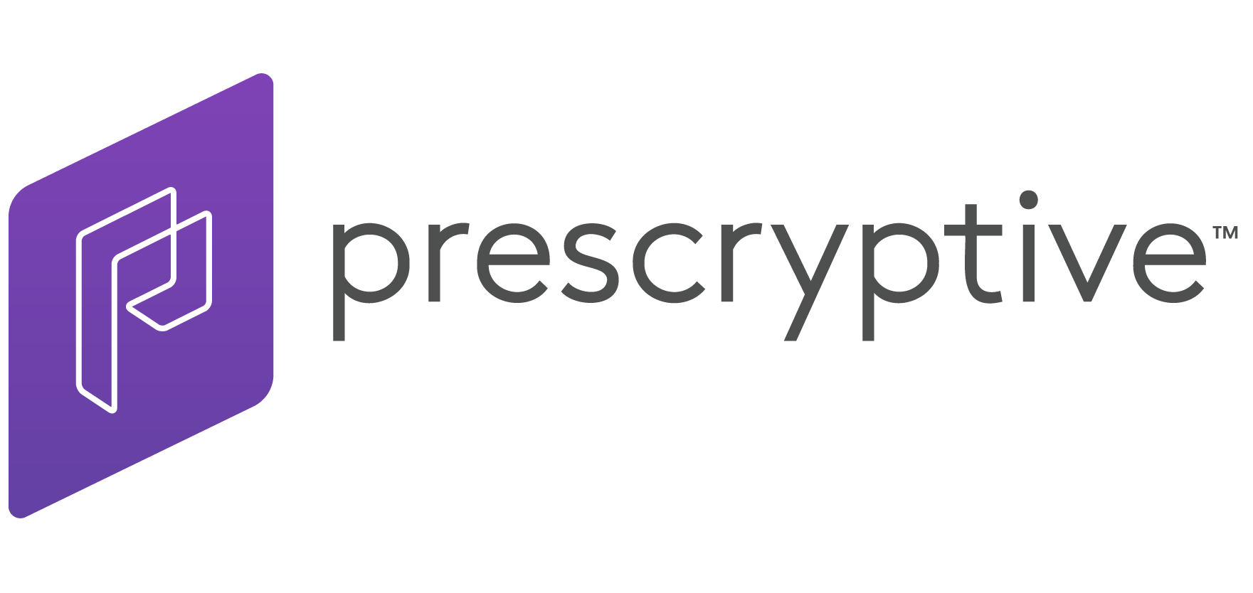
PBMs are highly concentrated (and vertically consolidated)
Largest PBMs all part of corporate entities that also include insurance
Other large PBMs
PLAN
Humana Pharmacy Solutions
Prime Therapeutics
MedImpact Healthcare Systems
PROVIDER
PBM disruptors
Only about 3% market share is owned by groups outside the top six mentioned here. To grow that share though, new entrants are almost universally focused on a price-transparency value proposition. Some also highlight their advanced data platforms or specialization in specific drugs
PBM
Three PBMs account for approximately 80% of equivalent Rx claims; this horizontal and vertical consolidation has heightened concerns around PBM anti-competitive behaviors, which are currently being invested by the FTC
Notes:
PBMs are highly concentrated and mostly owned by massive corporate entitles that also include health insurers, not to mention pharmacies. It’s a very, very tangled corporate web.
Here are some market diplomacy notes about PBMs. First of all, there are use cases for them or ways in which they are actually considered valuable by their customers, which is to say employers that are purchasing their services. Second, outside of this fan base, they are widely vilified as non-constructive drivers of health care cost and active obscurers of the already obscure drug value chain.
WITHIN PBMs, we would say they are used to being painted as ‘the bad guy’. They aim to stay out of the media and regulatory spotlight. If you ask a PBM industry professional what THEY are interested in, trendwise and topicwise, they will say things like the development of Humira biosimilars.. The fact that specialty pharmaceuticals are accounting for a larger proportion of drug spend… the emergence of startup PBMs (like Capital Rx, CleverRx and AscellaHealth). They are also waiting to see what, if anything, will come out of an investigation by the Federal Trade Commission (FTC) into the major PBMs.

Slide 27
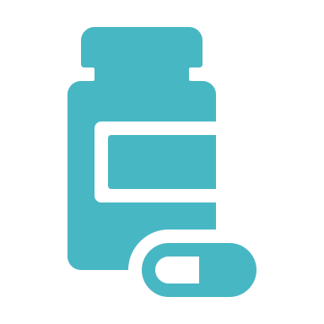
Topic #4: Supply shortages
“Drug Shortages Near an All-Time High, Leading to Rationing”
- The New York Times, May 17 2023
“A short supply of cancer drugs has doctors and patients worried: 'We're at a critical juncture'”
- USA Today, May 30 2023
Notable recent drug shortages illustrate common reasons for supply deficits
Adderall
Manufacturing issues aggravated by complex supply chain
Ozempic
Large, un-forecasted demand
Amoxicillin
Low-margin generic, little motivation to produce extra supply
Various cancer drugs
Overreliance on internationally-sourced ingredients
Notes:
Topic #4 that you will run into in the pharmacy/drug ecosystem space is drug shortage. Here is a rare example of a topic that is active, but not as contentious as the others in this terrain – all stakeholders agree that shortages are a problem, the question is what to do about them.
The first thing to know about shortages is that they are being experienced across multiple different drug types, and the reasons are often in common, but not always. In other words, the exact driver, or set of drivers, of the shortage somewhat depends on the drug in question. There’s everything from manufacturing issues to economic problems, such as “market failures” like there not being enough of a perceived incentive for manufacturers to invest heavily in producing certain kinds of drugs.

Slide 28
What’s being done to reduce future shortages
Civica Rx is a not-for-profit drug maker founded by hospitals, with the goal of stabilizing reserves of hospital-administered generics; in March 2023 Civica signed a $50M deal with California to produce low-cost insulin for the state
Because of the complex nature of drug supply chains, enhanced communication between stakeholders (manufactures, providers, governments, etc.) can recognize and resolve shortages before they reach crisis
Collaboration
Manufacturers are shoring up supply chain vulnerabilities (ex: relying on a single international supplier) by diversifying their sources
Diversification
Regulators can proactively address supply issues, through quality and compliance oversight, and have tools to mitigate the impact of shortages if they arise
Regulation
Once a drug shortage has been identified, the FDA has several levers it can pull to help increase supply, including accelerated regulatory approval, the importation or approval of alternatives, and direct assistance to manufacturers
Drug makers, suppliers, and providers are leveraging data analytics to create more accurate forecasts about future supply needs in order to keep pace with demand
Prediction
Notes:
What’s being done about the problem of shortages? Well a lot of things… [ read items on slide]
However, experts question whether all this activity is sufficient to get to resolution. Legislative action may be required.

Slide 29
Some informed, yet non-controversial talking points
Non-controversial talking points
Complex issue; current federal gov’t viewpoint seems to be ‘good products should be rewarded,’ AND, ‘absolute prices are too high, putting patient welfare at risk‘
High drug costs
Both manufacturers and a bipartisan groups of lawmakers have an interest in reforming the program, but a lack of aligned interest and government cost savings are detering change
340B Drug Pricing Program
Pharmacy benefit managers
PBMs are facing pressure from both flashy new entrants trying to shake up the model, as well as a growing list of state and federal lawmakers and regulators
Drug shortages have been getting a lot of attention as they persist even as the pandemic has waned; ripe target for bipartisan intervention
Supply shortages
Notes:
As you have seen, there are a lot of different controversies in the pharmacy/drug ecosystem space. If your goal is to participate in conversations in these areas in an informed, yet noncontroversial way, here are some talking points we would recommend.

Slide 30
Section 04
Focus areas by sector
Notes:
So far we have adopted a kind of “to whom it may concern” stance on facts and issues in pharmacy/the drug ecosystem. Let’s now pick up the industry viewpoint kaleidoscope and start clicking through the various lenses, adopting the worldview of different major players one at a time to see what this topic terrain looks like from their perspective.

Slide 31
The evergreen focus areas of pharma
Pharma viewpoint
General management team evergreen priorities (current issues up next)
R&D
Regulatory compliance
AKA pipeline
Marketing
Corporate portfolio
Physician- and consumer-facing
Mergers, acquisitions and divestitures.
Intellectual property protection
Supply chain optimization, resilience, security
Partnerships
E.g. with academia
Notes:
The drugmaker industry or “pharma companies” as they are collectively called, here are the major ongoing areas of activity that occupy the time of a general management team. This is anytime, any year.
Note that, not on the slide, but in the overlap between “R&D” and “intellectual property protection” is a practice known as “evergreening”. This refers to the practice of taking an existing patented drug and adding something new to extend the patent. The new thing could be a new method of administration or mixing it with another drug. NOTE there is some sensitivity around the term -- or at least the implication that this is a profit strategy rather than legitimate development.
Also, a note on “corporate portfolio” -- M&A is a major way that drugmakers shift around their product portfolio. Life sciences deal activity was extremely high across in 2020 and 2021; though it slowed slightly in 2022, 2023 is shaping up to be another blockbuster as makers buy smaller manufacturers
Related statistics:
Number of M&A deals: https://www2.deloitte.com/us/en/pages/life-sciences-and-health-care/articles/mergers-and-acquisitions-trends-survey-life-sciences.html
Biosimilar CAGR: https://www.globenewswire.com/en/news-release/2023/02/28/2616776/0/en/Biosimilars-Market-is-Anticipated-to-Grow-at-a-CAGR-of-14-1-from-2023-2032-due-to-Increasing-Incidences-of-Chronic-Diseases.html
FDA approvals: https://www.personalizedmedicinecoalition.org/Userfiles/PMC-Corporate/file/Personalized_Medicine_at_FDA_The_Scope_Significance_of_Progress_in_2021.pdf

Slide 32
Selected pharma company focus areas of 2023-2024
Gene and cell therapies (especially for cancer and genetic disorders)
Artificial intelligence (AI) and machine learning (ML), especially in in drug discovery, clinical trials
Value-based and outcomes-based pricing
Precision medicine (key terms: genomics, biomarkers)
Digital health and telemedicine: Remote monitoring, digital therapeutics, virtual clinical trials, and online prescribing
Medicare drug price negotiation (advocating against)
Metabolic therapies for weight loss and chronic condition management
Data privacy and cybersecurity (major compliance area)
340B (advocating against)
Notes:
For 2023 specifically, here are some issues that are bubbling to the top of the general management team priority list.
Not on the slide, but if we had to add one more it would be about how Many pharma companies are investing heavily in developing Biosimilars, which allow makers to undercut the price of a drug’s more expensive biologic counterpart These have been hitting the market at an impressive pace, despite legal push-back from competitors.

Slide 33
Drugmakers want to prove they aren’t the problem
How pharmaceutical companies
see themselves
How pharmaceutical companies
see other stakeholders
PBMs and insurers
Drug makers and their workforce in general perceive themselves as innovation drivers and creators of life-saving tools
PBMs, and their insurance company owners, are the primary culprit that drug makers point to for raising the cost of prescription medications
Providers and hospitals
High prices are perceived as the logical and necessary byproduct of experimentation in a complex and risky industry
While physicians are a key customer group that manufacturers target, drug makers are fed up with hospitals ‘gaming’ the 340B system for profit
The government
Within organizations, there’s varying levels of familiarity with the perception of pharmaceuticals companies as “bad guys”
Drug makers must keep the government happy to ensure ongoing funding and stave off regulation, but recent price negation rules have them seeing red
Notes:
Naturally people who work for drugmakers, or lobbying groups, vendors and other allies of the industry, are unlikely to view themselves as the ‘bad guy’ in any pharma controversy. On the left are some key points about how people who work in and around these organizations view themselves, their organizations, and the cost problem.
On the right, here is a very pharma-centric lens on other players in the industry.

Slide 34
Docs have tried to stay above the pharma fray
Physician viewpoint
Physician attitudes surrounding various pharmaceutical topics
Positive
Mixed
Mixed
Negative
Providers appreciate that new drugs give them another tool in their toolbelt and can significantly improve quality of life for their patients
Most physicians do not generate any profits from drugs, and express concerns about prohibitive pricing; however, a share of specialists do generate profits from buying drugs wholesale and charging for them (ex: oncology)
While pharmaceutical representatives can be useful sources of information about ever-changing treatment options, providers are wary about getting wrapped up in improper gifts and incentives
Many providers express significant frustration with the prior authorization process for drugs, however that aggravation is generally directed toward insurance companies rather than drugmakers or distributers
Opioid crisis has strained physician trust
A growing pool of evidence is indicating that opioid manufacturers and their representatives purposely understated and, in some cases, openly lied about the addictive properties of their opiates; studies are also suggesting that even small gifts and incentives from drug reps have an impact on prescribing behavior. All this has fomented distrust between drug makers are physicians, and between physicians and regulators
Notes:
Physicians have many different feelings about drugs and the pharmacy industry—as this slide shows, those feelings range from positive (drugs as an essential tool for helping patients) through mixed, to negative (prior authorization—and of course prices). We think it’s fair to say that when it comes to drug prices, many physicians have taken a "head in the sand" approach to drug prices. ("I don't know how much it costs, and I don't want to know.") But it's increasingly hard for them to stay ignorant of the prices their patients are paying.

Slide 35
Hospital systems can benefit from Rx discovery and sale
Hospital/system viewpoint
Profit center
Cost center
Out-patient drugs in particular can be profitable for hospitals, thanks in part to the 340B program
Hospitals don’t want to be accused of profiteering, and can lose money on publicly- or un-reimbursed drugs
Social benefit
Logistics challenge
Health systems have significant appreciation for the medical benefits derived from prescription drugs
The complexities of purchasing, inventory, safety, and diversion prevention are headaches for hospitals
Role of hospitals in drug development
Hospitals and health systems have long supported the discovery and development of new pharmaceuticals by facilitating clinical trials; increasingly they are helping capture real-world evidence as well
Notes:
The hospital, or hospital-heavy health system, view on drugs is a complex one in part because drug economics get very complicated at this kind of healthcare organization. For hospitals and health systems, drugs can be BOTH a revenue and profit center, AND a cost center that drags down margins. Also, similarly to physicians, hospitals and health systems’ leaders have appreciation for the clinical necessity and/or major benefits of drugs, while also stressing hard about the logistical, strategic, and economic issues around drugs.
Last but not least at the bottom – important to remember that hospitals and health systems—especially ACADEMIC hospitals and systems – play a significant role in drug R&D, with economics and institutional identity very intertwined with this part of the drug landscape. And many hospitals and systems – NOT just academics – are heavily involved in clinical trials and the gathering of real-world evidence as part of the clinical trial world.

Slide 36
Insurance companies play both sides of the field
Insurance viewpoint
Insurer incentives
Pay for drugs
Profit from drugs
Reimbursing for prescriptions makes drugs a cost driver for insurers, especially when covering fully-insured employers or capitated enrollees (e.g. Medicare Advantage participants)
Most large insurance companies own their own PBM, which derives revenue from percent of sales price, and/or specialty pharmacies, which collect dispensing and administration fees
Prices can go up…until they can’t
In the short-term, rising drug prices are not a huge concern for the insurers—they can increase premiums to offset the cost, which has the added benefit of raising the absolute amount of the MLR that they get to keep. However, if payers start refusing larger and larger premiums, or successfully push plans to take on a larger risk burden, it would be a threat to their existing business model and ability to play both sides.
Notes:
If the drug-related economics of providers weren’t complex enough – insurance companies– or the increasingly diversified corporate entities that INCLUDE insurance companies – also have both revenue-generating and cost-reducing incentives when it comes to drugs.
At the bottom, always remember that if costs are going up in healthcare, similar to a PBM, health insurers end up benefitting as long as premiums keep pace (because their profit margins are capped, so bigger costs mean more absolute dollars flowing through same regulated percentage going to profit).

Slide 37
Employers are frustrated with cost and complexity
Employer viewpoint
Change is difficult
New policy may increase pressure
The complexities of PBM pricing, employers’ main entry point into Rx spend, make quantifying value and comparing alternatives a challenge; not to mention employee push-back to benefits change
The Inflation Reduction Act contained new rules requiring employers to track benefit spend more closely. This may motivate employers to demand more transparency/value from PBMs and others
In 2022, 99% of employers were concerned about drug costs; 53% said lower drug costs should be a top priority for health reform
Some activated employers are partnering with third-parties to test strategies that would allow them to break away from the traditional model
Employers are dissatisfied
Interest grown for alternatives
Examples include a partnership between Walmart and benefits platform Transcarent, which would give employers access to Walmart’s lower-cost drugs, and the decision by employer-coalition Pacific Business Group on Health to start its own PBM, AffirmedRx.
Notes:
Employers (aside from pharmaceutical companies of course) have a much more straightforward relationship to the topic of drugs. Basically, they are frustrated, concerned, and looking for solutions to increasing costs when it comes to covering employee and family prescriptions.
This is true across the board but some important distinctions among the kinds of drugs they are concerned about….
Further reading: https://ww2.businessgrouphealth.org/acton/attachment/32043/f-7262a100-64a9-4b52-96f4-37a344f9fc47/1/-/-/-/-/2023_PDS-Exec%20Summary.pdf

Slide 38
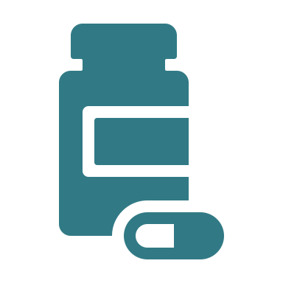
#1 pharma issue for employers? Specialty drugs
Specialty drugs account for a median 12% of all employer healthcare spend
Specialty drug spending is projected to grow 4x faster than non-specialty spending
Fig. 27: Employer adoption of strategies to reduce specialty drug spending, 2023
Due to the high cost of specialty drugs, and the complexity of the conditions they treat, a small but growing share of employers are adopting tactics to affirm that these expensive medications will be effective before paying the full ticket price
Prior authorization for specialty drugs
Site-of-care management
Extensive case management
Approval of limited initial supplies only
Carved-out pharmacy for specialty drugs
Companion testing to determine drug appropriateness
Set outcomes-based prices w/manufacturers
Pharmacy and medical benefit
Pharmacy benefit only
Medical benefit only
Source: Business Group on Health, “2023 Large Employers’ Health Care Strategy and Plan Design Survey,” August 2022.
Notes:
It’s worth calling out that employers are especially concerned right now with the rising cost of specialty drugs. Not on the slide but the top spend category that employers are worried about in general recently switched from musculoskeletal (think, spine surgeries) to cancer – and one of the major concerns about cancer is the prevalence of increasingly high-cost specialty drugs. Take a look at the statistics about the specialty drug PROBLEM along the top….
…. And some example employer strategies to try to mitigate the specialty drug problem along the bottom of the slide.
Source: Business Group on Health, “2023 Large Employers’ Health Care Strategy and Plan Design Survey,” August 2022.

Slide 39
Gov must balance free market with public interest
Government viewpoint
The federal government plays an active role throughout the entire drug ecosystem, from funding research at one end to being a major purchaser of drugs at the other
Pharmacy benefit managers
Payers
Both regulatory and legislative bodies are taking a hard look at the role of PBMs
State and national lawmakers dictate public and private payer rules
Last year the Federal Trade Commission launched an investigation into the impact of PBMs on the cost of pharmaceuticals and patient access, citing opacity and anticompetitive behavior
The Inflation Reduction Act regulates how much Medicare will pay for certain drugs, while the 2021 The Consolidated Appropriations Act outlines new pharmaceutical reporting requirements for employers
Life science value chain
Manufacturers
Pharmacies and providers
Life sciences companies have a very active lobbying presence on Capital Hill; PhRMA, the main Rx trade group, alone spent about $30M on lobbying last year
Federal government oversees drug production and funds drug discovery
The government sets reimbursement rates for Medicare and Medicaid
The National Institutes of Health are the largest public funders of biomedical research in the world, leading some to argue that US citizens “pay twice” for drugs and should be entitled to lower prices
In 2018 CMS attempted to cut hospital reimbursement rates for Part B drugs purchased through the 340B program; last year the Supreme Court ruled in favor of hospitals and against the cuts, which both the Trump and Biden admin supported
Notes:
Switching hats to the government viewpoint, especially the federal government – basically the drug problem is a microcosm of the healthcare problem. That is, the drug ecosystem is a MASSIVE part of the healthcare economy – which is a massive part of the national economy – and no one in the federal government wants to put a dent into that, nor do they want to run afoul of the major lobbying interests associated with the industry. On the other hand, there is a clear public interest mandate to keep drug costs low and drugs accessible and safe. This makes regulating pharmacy and the drug ecosystem a constant balancing act.
On this slide, follow along the life science value chain chronologically, noting all the different ways in which government interest and activity appears along the way.

Slide 40
Section 05
Case studies of key players
Notes:
A graphic that shows the ‘value chain’ briefly lists broad player categories such as ‘manufacturers’ and ‘pharmacies’. In the real world, of course, it’s useful to understand these player types in a little more detail. So let’s establish a ‘major players’ learning layer. We put organizations into a few big categories, and then pick representative organizations to get to know in each, case-study style. What kind of organizations are these, what kind of economics do they have, what keystone people/stories do industry insiders tend to know about them?

Slide 41
Put major drugs/pharmacy players in categories
Here are five conceptual anchors for ‘getting’ the life sciences landscape as a whole
E.g. CVS, Walgreens
Examples:
Pfizer, J&J,
AbbVie, Merck
Conglomerates
E.g., STAT Plus, Drug Channels
Biotech ‘startups’
Disruptors
Pharma giants
Wholesalers
Go-to info sources
E.g., bluebird, moderna
E.g., GoodRX, Marc Cuban CostPlus, Civica RX
Amerisource Bergan, McKesson, Cardinal Health
Notes:
An informed set of players in drugs/pharmacy will include both organizations that are often in the headlines and organizations that fly under the radar unless you're in the know. For example, take wholesalers such as Amerisource Bergen, McKesson, and Cardinal Health. As our go-to drug/pharmacy expert Lindsay Conway, Director at Vynamic, puts it: "These are the biggest, most influential organizations in pharmacy that most people don't know anything about." All three of the above companies are among the top-20 largest companies in the U.S.
People like to say about organizations, ‘if you know one, you know one’, but in my opinion, getting to know one organization in a category is a huge leg up on understanding any industry sector at large. After all, once you have foundational familiarity with one, you’re in a position to compare and contrast with others in the category. To take a drug/pharmacy example: if you understand what GoodRx does as a drug/pharmacy disruptor, it’s much more feasible to add Marc Cuban's CostPlus and Civica Rx to your repertoire, gaining different angles and nuances on the general theme of drug/pharmacy disruption.

Slide 42
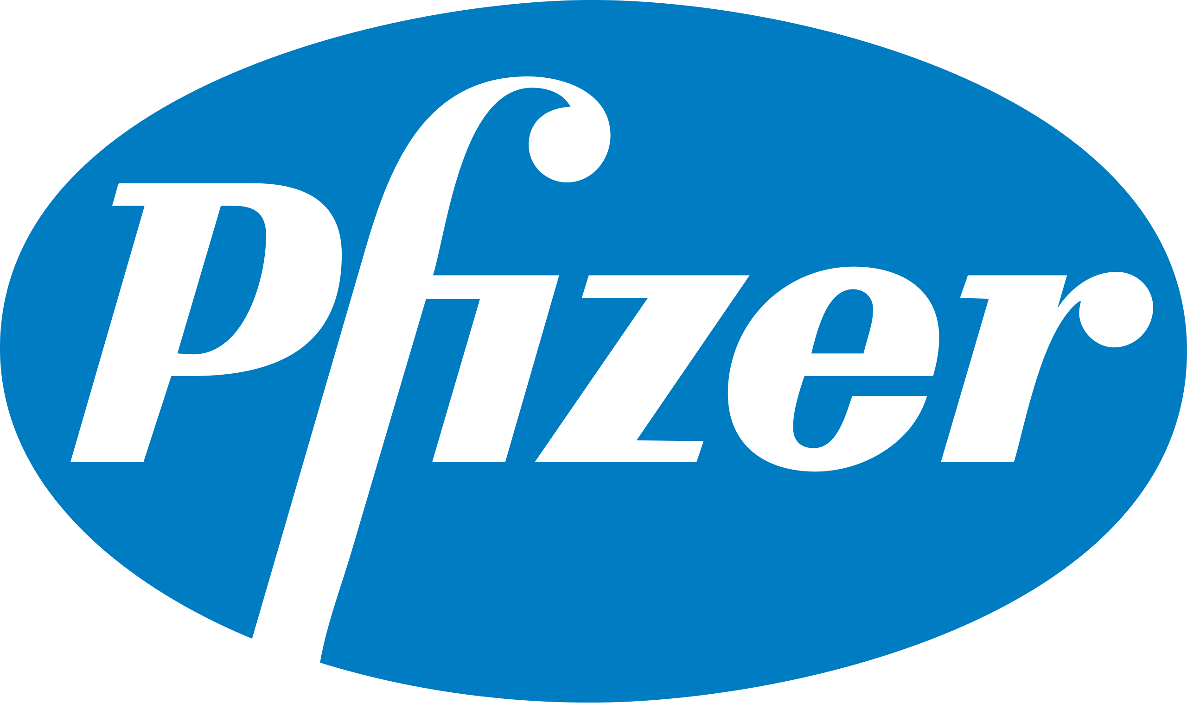
Example of market megafuana:
Pfizer Pfacts
Founded in 1849 in New York City, where headquarters remain today
Employs 83,000 people across the globe
Sells products in 101 countries and operates 36 manufacturing sites
See also: Johnson & Johnson, Roche, Merck & Co., AbbVie, Novartis
Unifying characteristics
Pfizer specifics
Huge revenue streams
As of 2022, Pfizer was the largest pharmaceutical company in the world by revenue, at $100.3B; the top six all have annual revenues above $50B
Diversified business lines
Pfizer’s core product is prescription drugs and vaccines, but they also have other business lines such as OTC medications, medical devices, and even animal health products
The “Wonder Drug” effect
Pfizer leads the world in Covid vaccines and treatments; while revenue and share price spiked in the short-term, waning demand has hampered its ability to meet performance goals
Acquisition and oversight
Last year Pfizer acquired four smaller life sciences firms, however a much larger proposed deal to purchase Seagen Inc. is under review by the FTC
Notes:
Note the top six publicly traded pharma companies all had revenues above $50 B in 2022. The largest are highly diversified into all segments, even see some outside of the human life sciences space (animal health or personal care products). This is probably related to the nature of pharmaceuticals (new better treatment, cyclical disease, patent expiration) which can lead to boom-and-bust cycles. Diversification mitigates those highs and lows.
With that as context, let’s get to know a quintessential “big pharma” player – Pfizer, in a bit more detail.
Pfizer is an old (1800s) corporation with massive revenue -- $100.3 B in 2022, a record for them, driven by covid products (Comirnity – the vaccine– and paxlovid) but likely to dip. Followed by j & J with $95 B. Main business lines include prescription and over the counter medications, with a major focus on vaccines in particular, and the small medical device segment.

Slide 43
An example of a (once) rockstar start-up
Business
Challenges
Founded in 1992, became a dedicated gene therapy company in 2021
First and only approved products hit the market in 2022; Zynteglo ($2.8M) and Skysona ($3M) are two of the most expensive drugs in the U.S.
So far five patients have initiated treatment
Submitted an FDA application for a third drug to treat sickle cell disease in April 2023
The company’s 2022 revenue was $3.6M, compared to $3.7 in 2021
Since 2013 IPO, stock price has risen from $17 to over $100 in 2018, now sits at just over $3; took another hit earlier this year after announced regulatory delays
Cut about 30% of its staff in Q1 2022 due largely to two major hurdles:
The company ended drug sales in Europe after failing to secure favorable pricing; now only focus on U.S. market
Delayed FDA approval for its first two products
All together the market for two existing treatments is about 2,000 patients; would increase by 20,000 if sickle cell therapy approved
There’s a lot of money is this sector…
…but that does not mean its easy to get
Notes:
In contrast, let’s look at an example of a small “startup” biotech company whose revenue is all tied to making a very small number of very high-ticket sales of one drug. Take a look at their profile information here on the slide.

Slide 44
A silent giant:
Anatomy of a “pharmaceutical solutions organization”
Last year AmerisourceBergen (ABC) launched a $150M venture fund investing in emerging healthcare technology and digital tools.
For nearly 40 years, ABC has provided practice management services to independent pharmacies through its Good Neighbor Pharmacies network; this year it expanded its network ownership to physician practices with the joint purchase of independent oncology network OneOncology. While the doctors and practices remain independent, the network takes over certain operational tasks and provides members access to growth capital and economies of scale. McKesson, ABC’s primary competitor, acquired a similar network, US Oncology, in 2010.
Venture fund investments
Emerging revenue stream:
Practice management
ABC offers software and other operational support (ex: R&D, supply chain) for every step along the value chain, from manufacturers to providers.
Scaled expansion:
Industry support
Full year 2022 revenue:
$238.6B, #10 on the Fortune 500
Comparable competitors:
McKesson, $264B
Cardinal Health, $181.4B
The primary business line of drug distributers (i.e. bulk purchasing drugs from manufacturers and reselling to providers and pharmacies) has gotten a boost as pharmaceutical purchases increase.
Core business:
Core Business:
Drug distribution
Notes:
Case study #3 helps shed light on the world of distributers/wholesalers. Think of them as the interstitial tissue that holds the drug supply chain together. Most of the time, they're just there, out of the limelight; the bigger the drug economy, the better they do. And of course, if/when they make changes, they can have implications for a lot of stakeholders. Here’s Amerisource Bergen. Headquartered in Conshohocken, PA– take a look at the information on the slide.

Slide 45
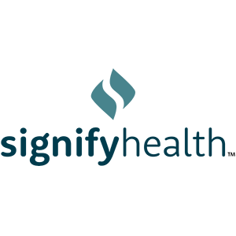
Inside a conglomerate:
CVS was founded in 1963 as a health and beauty retailor, and opened its pharmacy in 1967; as of 2022 it was ranked 4th on the Fortune 500 with an annual revenue of $322.5 billion. NOTE: In December, 2023 it made headlines by announcing it would adopt a new ‘cost plus’ model for its pharmacies and PBM
Health benefits
Retail
PBM
2022 revenue: $91.4 billion
2022 operating income: $5 billion
2022 revenue: $106.6 billion
2022 operating income: $6.7 billion
2022 revenue: $169.2 billion
2022 operating income: $7.4 billion
Acquired health insurance company Aetna in 2018, making it the third largest health plan by membership in 2022
Operates nearly 10,000 retail locations, which employ ~30,000 pharmacists; over 1,000 sites include a MinuteClinic
As the largest business line, PBM services began when CVS launched its own PBM in 1994 and grew significantly with the 2007 acquisition of Caremark
Pivoting to providers: In March, CVS completed its acquisition of provider-enablement platform Signify Health for $8B and in May finalized the $10.6B purchase of primary-care company Oak Street Health
Notes:
Turning to another major corporate entity, this one a ‘conglomerate’, the other major example of which is walgreens : CVS health. Let’s start with their magnitude – they are the 4th biggest company in the country, and the biggest health care company in the world. And their biggest revenue driver is…. their PBM. Let that sink in
Take a look at the activities and aspects covered on this slide.
Not on the slide, but interesting, in 2023 CVS announced it was closing its clinical trails unit after less than two year to “focus on its core business.” With the clinical trails segment seemingly driving only a small portion of revenue, and the company’s clear pivot toward providers and clinical care, its likely they saw the trials trial as a distraction from a much larger potential profit center, and left the sector to the likes of Walmart, Walgreens, and Kroger, who have all recently launched clinical trials initiatives.
Source: Source: Mathews, A. “CVS Plans to Overhaul How Much Drugs Cost”, Wall Street Journal, December 5, 2023

Slide 46
A drug channel disruptor:
Background
Launched in Jan. 2022 as a public benefit company and drug wholesaler; recently filed to become PBM
Purchases drugs directly from makers and sells online at a flat markup of 15%; considering getting into manufacturing business
Business model
Garnered at least $25 million in sale in the first nine months of operations; projects that it will achieve profitability this year
Revenue
Dec. 2022 partners with EmsanaRx* to expand access to employers; Apr. 2023 began selling several brand-name drugs, including one blockbuster**
Big moves
CivicaRx: Non-profit generic pharmaceutical company manufacturing drugs with the goal of mitigating shortages and price hikes
AffirmedRx (*formerly EmsanaRx): Public benefit corp. PBM for self-funded employers started by PBGH’s spinoff Emsana
Presryptive Health: Tech-forward PBM start up that uses data to provide patients with transparent prices and lower-cost alternatives
CVS announced in December, 2023 that it would adopt a new cost-plus model for its pharmacy reimbursement, potentially giving this model a significant boost in overall traction in the market.
See also
See also
Notes:
Now let’s switch to a profile of a disruptor. Marc Cuban CostPlus drug company.
Note that In a lot of the drug shortages discussion, some people are blaming GPOs for demanding lower prices for generic drugs. (CivicaRx is an interesting counter to that - their members are explicitly paying more for a RELIABLE supply of generics.

Slide 47
From insiders, to insiders
Background
Business
Founded as an online publication in 2006 by economist Adam Fein Ph.D
Produces articles and reports on the pharmaceutical industry (supported by advertising and co-branded content ), as well as paid webinars and education tools
Readership
Perspective
With 65,000 subscribers, the site is considered the source for industry deep cuts
Known for mapping intricate financial relationships; sometimes takes a critical view of plan sponsors (ex: alternative payment models) and hospitals (ex: 340B)
Niche insights for specialists, litmus test for generalists
While the primary benefits of Drug Channels to life sciences experts is of course topical industry info unlikely to be found in other publications, healthcare generalists can also leverage the site to test their subject matter fluency (think, watching TV in a foreign language without the subtitles-–are you following what’s being said?)
Notes:
Our last case study is an exemplar of the INFORMATION world specific to the drug ecosystem. The other major one that leaps to mind is STAT Plus, which has extensive coverage of pharma issues. But StatPLUS (which was founded by a bunch of Boston Globe alums), is pitched at a moderately general, or at least general healthcare industry, audience.
In contrast, “Drug Channels” by Adam Fein is a real insider’s source of information. It has a definite worldview, largely a pharma-friendly one (so, tends to be critical of PBMs, 340b, and hospitals/health systems). Contains instructional materials but, in our view, ones that may prove inaccessible to new health care learners.
Our favorite use of drug channels is basically as a self-test or opportunity to be a fly on the wall of insider conversations and see if you can understand what in the world is being discussed. If you’re about to talk to a client with a pharmacy background or on a pharmacy topic, it would behoove you to take a few minutes to browse the topics on Drug Channels. As you run across unfamiliar jargon, stop and look things up. Worst case, you’ll be coming in with close to their own baseline understanding, best case you might even impress them!

Slide 48
Teach-back and take-aways

Slide 49
What did you learn today? Teach it back
Savvy-generalist cornerstones
01
Language
Recognize and use core concepts and specialized terms
02
High-level trends
Know the big patterns and trends: Utilization, investment, reimbursement, regulation
03
Market diplomacy
Areas of high sensitivity, major topics. Develop a set of informed, yet non-controversial, talking points
04
Focus areas (and economics) by sector
Each major player’s goals and activities in this area
(e.g. payers, providers, employers)
05
Some key players
A handful of anchor organizations/ people/ information sources to know
Appendix: A short, current reading list of additional, optional deep dives

Slide 50
What’s one personal take-away from our time?

Slide 51
Appendix: 2023 pharmacy/life science reading list

Slide 52
Six worthy life sciences reads
Price Increases for Prescription Drugs, 2016-2022
Explaining the Prescription Drug Provisions in the Inflation Reduction Act
Big pharma’s patent cliff is fast approaching
The Economist, April 2023
ASPE, September 2023
KFF, January 2023
Bipartisan framework to address the prescription drug supply chain
Major 340B Drug Pricing Program Developments Implicate Program Scope
Top Pharma Companies 2023: A Satisfactory Year
Senate Finance Committee, April 2023
PharmaLive,
October 2023
Sidley, November, 2023
Notes:
https://www.bcg.com/publications/2023/driving-the-future-of-digital-health
Bonus: Great article on drug pricing. https://jamanetwork.com/journals/jama/article-abstract/2545691

